Slide 1
Air Pollution in the Tristate & Nationwide: Trends & Health Effects
Project 2
Group Name: Socially Distant Breathing!!
Group Members:
Zuhair Shahzad, Saniya Sule, Eric Meyer, Parag Patel, Bhavani Sathya

Slide 2
Data
United States Environmental Protection Agency (EPA) Air Quality Data
Nationwide Air Quality Index (AQI) data (by state, county from 1980-2019)
10 years of individual gas pollutant data (nationwide, by state)
Carbon Monoxide (CO)
Nitrogen Dioxide (NO₂)
Ozone (O₃)
Sulfur Dioxide (SO₂)
https://www.epa.gov/outdoor-air-quality-data/air-data-basic-information
https://www.epa.gov/criteria-air-pollutants/naaqs-table

Slide 3
Javascript Libraries Used
canvas.js
Library based on html5 language (HTML5 is a markup language used for structuring and presenting content on the World Wide Web)
World’s best companies use CanvasJS to Visualize their Data like NASA, Microsoft, Boeing, Apple, Bank of America
D3.js
Plotly
Leaflet

Slide 4
Data Visualizations
Stacked Bar Pollutant AQI Days
Multi-Series Line Charts by Individual Pollutants
AQI Maps - Tristate
AQI Donut Chart - Days by Pollutant (by State)
AQI Bubble Map

Slide 5
Platform
W3 webpage template – responsive design
Carousel – image slide show
iFrames – video links
List Group – website links

Slide 6
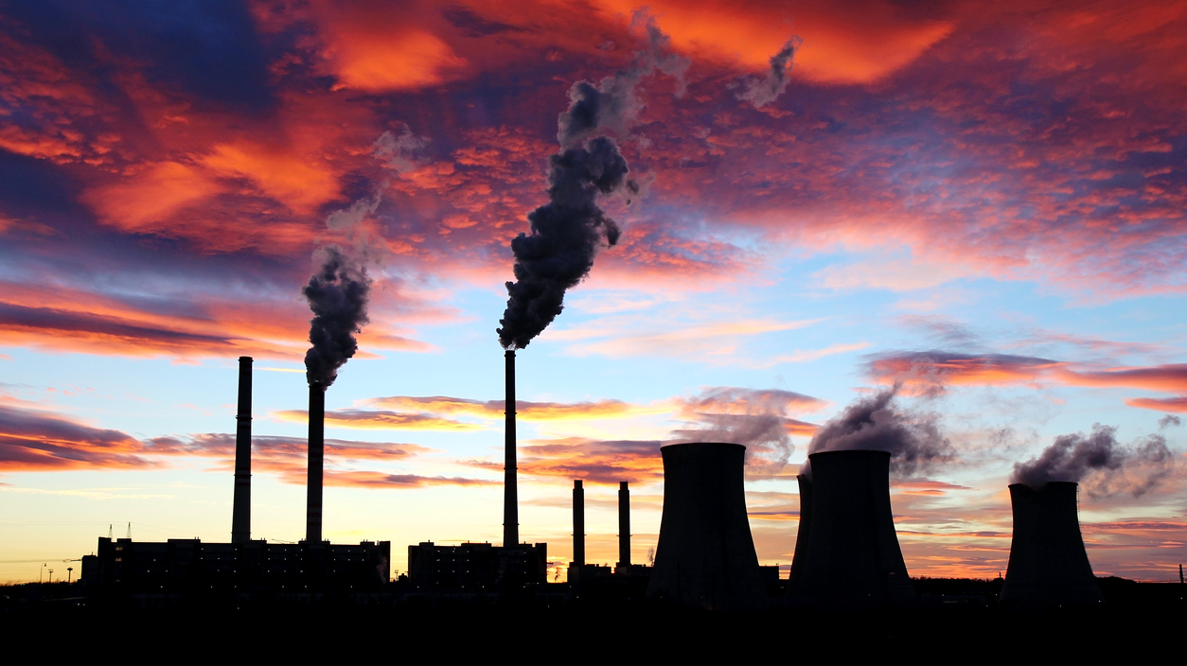
Final Visualization
https://zuhair21993.github.io/Socially-Distant-Breathing/

Slide 7
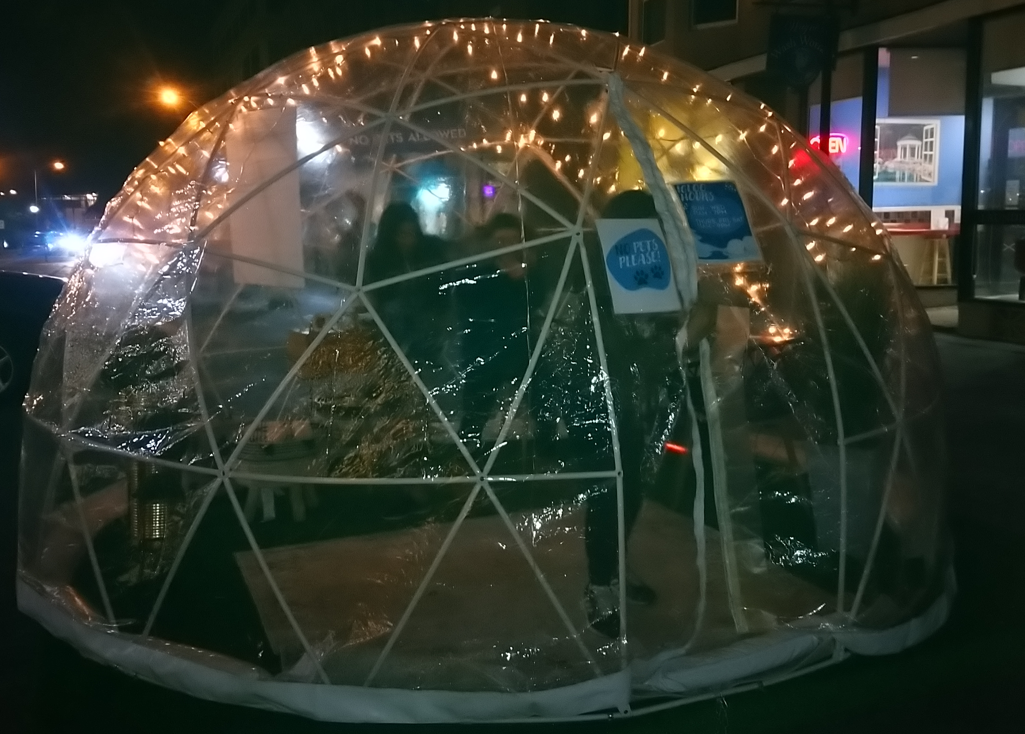

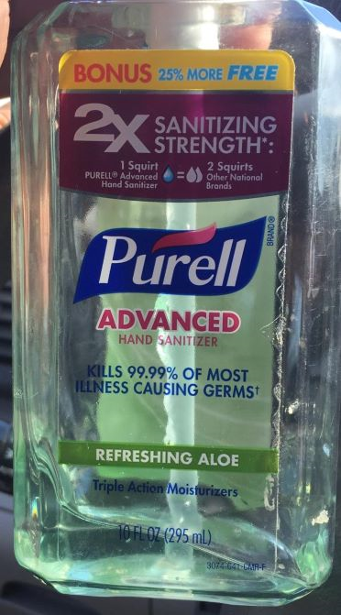










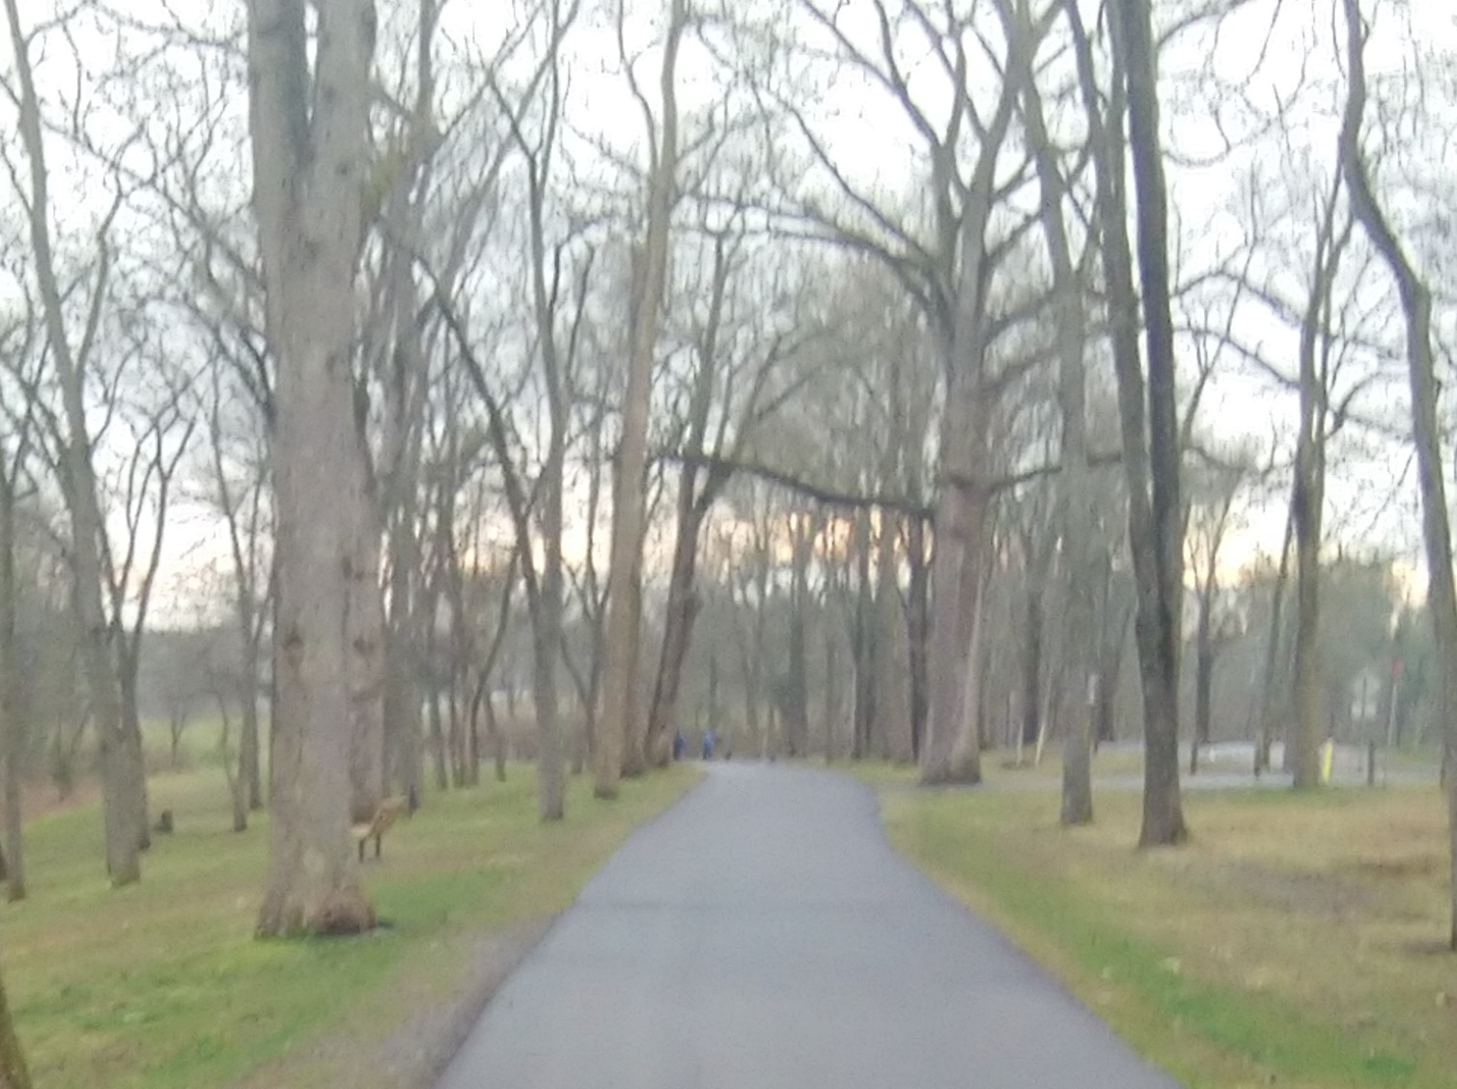

Data Sci Bootcamp in the Time of Coronavirus
Images of Socially Distant Life!!

Slide 8
Questions?

